Slide 1

Vivekanand Education Society’s Institute Of Technology Department Of Information Technology
DSA mini Project
A.Y. 2025-26
Title:
Sustainability Goal :
Domain: Data structure and algorithm
Member:Vinay motwani
Div no :-D10B
ROLL NO :- 39

Slide 2




S1Ë0319B0153H1
*uauudo aoaQa ^{q}e"!el5°S°°9

Slide 3
Content
Introduction to the Project
Problem Statement
Objectives of the Project
Scope of the Project
Requirements of the System (Hardware, Software)
ER Diagram of the Proposed System
Data Structure & Concepts Used
Algorithm Explanation
Time and Space Complexity
Front End
Implementation
Gantt Chart
13. Test Cases 14.Challenges and Solutions
Future Scope
Code
Output Screenshots
Conclusion
References (in IEEE Format)

Slide 4
Introduction to Project
The project is a Tic-Tac-Toe game developed in C code on a 3x3 board.
It features a human player, represented by 'X', playing against a computer AI, represented by 'O'.
The AI's decision-making is driven by the Minimax algorithm to determine the best possible move.
The game state is evaluated using a scoring system:
AI win: +10 points
Player win: -10 points

Slide 5
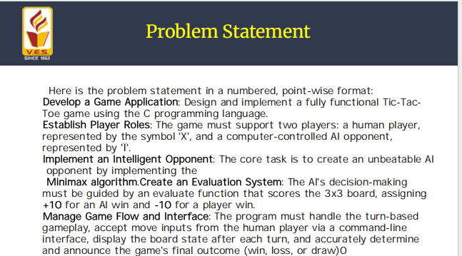

Slide 6
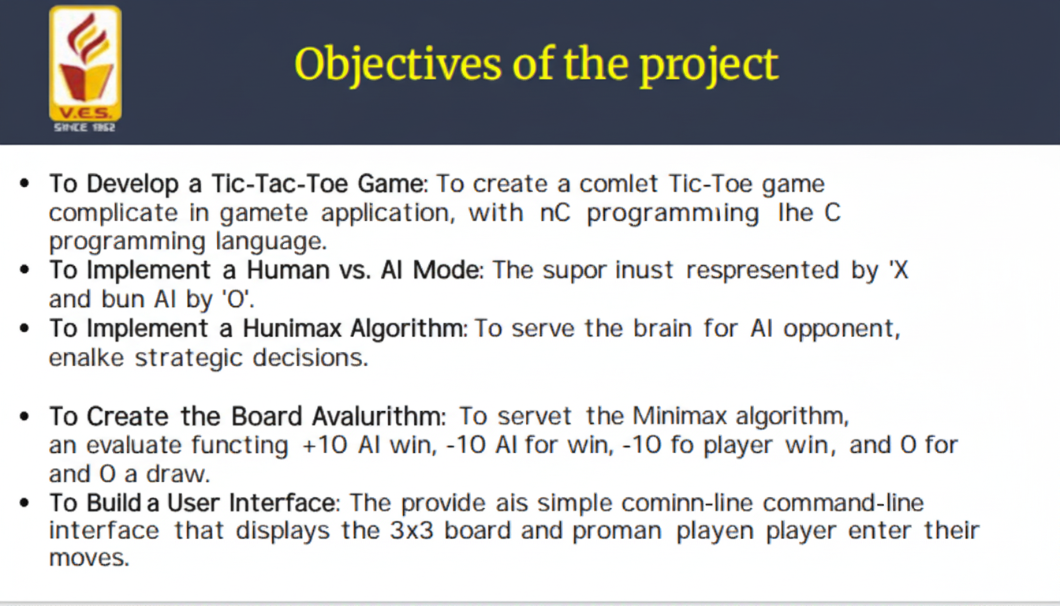
Objectives of the project

Slide 7
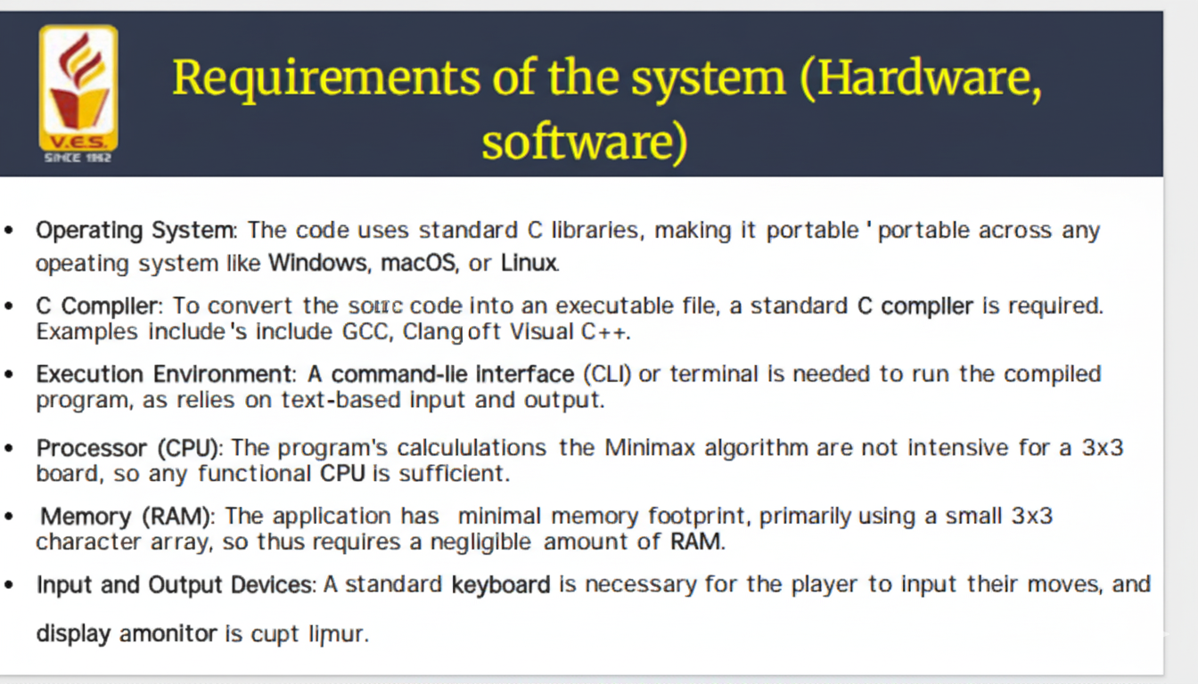
Requirements of the system (Hardware,
software)

Slide 8
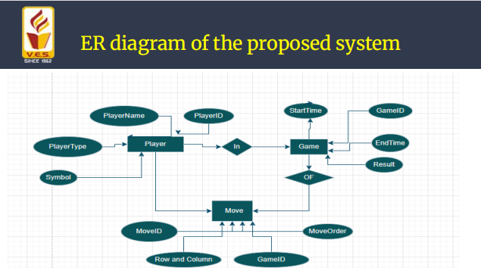
ER diagram of the proposed system

Slide 9
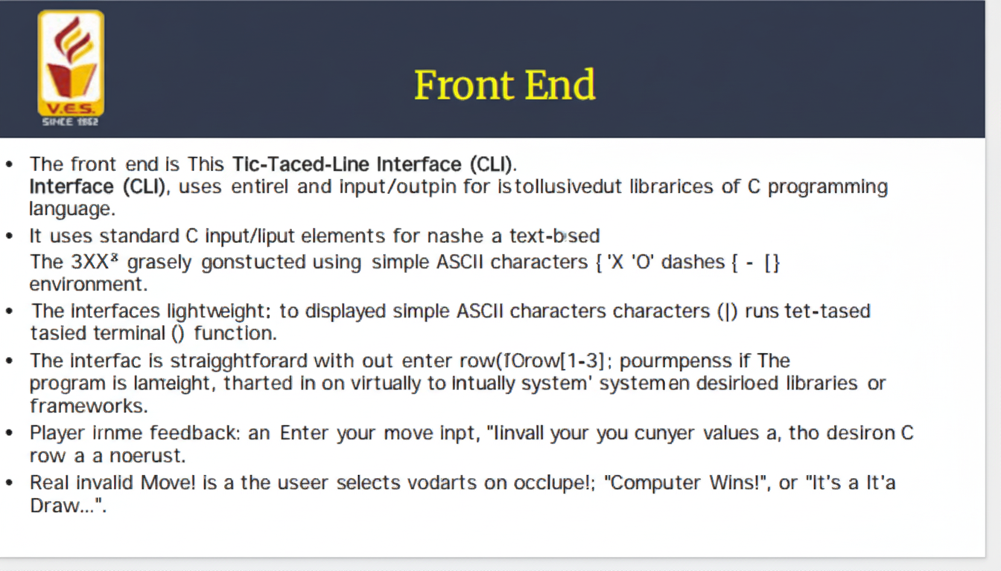
Front End

Slide 10
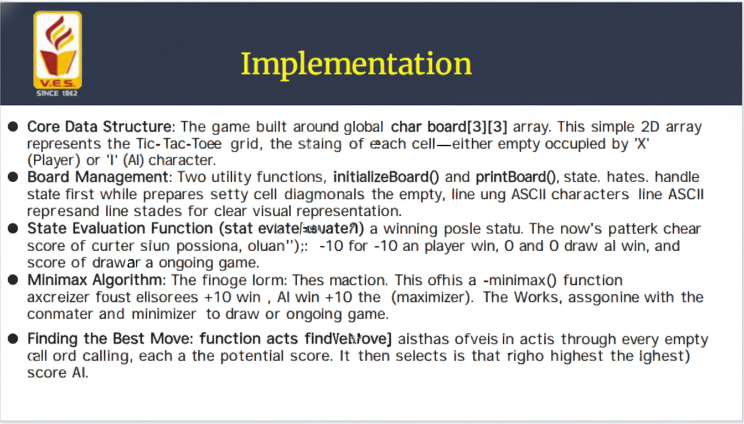
Implementation

Slide 11
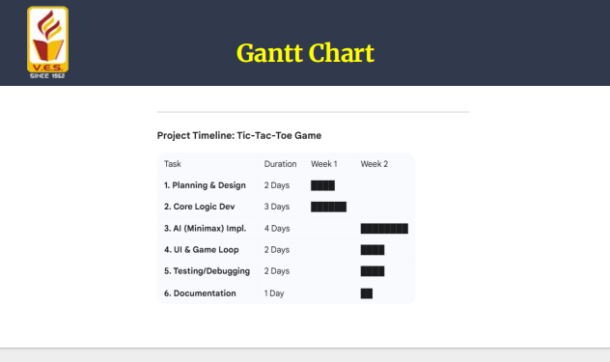
Gantt Chart

Slide 12
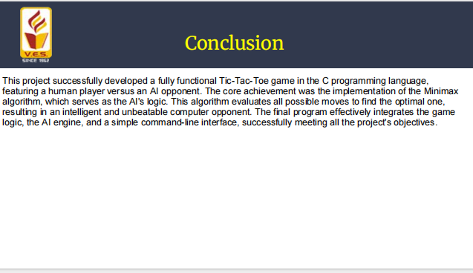
Conclusion

Slide 13
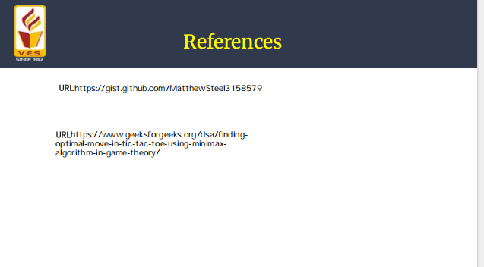
References

